Slide 1

JVM Memory Management - Garbage Collection, GC Tools
Azat Satklichov
azats@seznam.cz,
https://github.com/azatsatklichov/Java-Features/tree/master/src/main/java/features/jvm/memory/management

Slide 2
Agenda
Java Garbage Collector
Where Storage Lives
Types of Garbage Collections
Java Memory Model
How Garbage Collection Works – Minor, Major and Full GC
Garbage Collectors Implementations
Garbage Collection Tools - MXBeans, jstat, visualvm, visualgc
Notes:
Memory management is a crucial element in many types of applications.
Consider a program that reads in large amounts of data, say from somewhere else
on a network, and then writes that data into a database on a hard drive. A typical
design would be to read the data into some sort of collection in memory, perform
some operations on the data, and then write the data into the database.
This operation might be performed thousands of times, and in languages
like C or C++ that do not offer automatic garbage collection, a small flaw in the
logic that manually empties or deletes the collection data structures can allow small
amounts of memory to be improperly reclaimed or lost. Forever.
https://www.betsol.com/blog/java-memory-management-for-java-virtual-machine-jvm/
http://tutorials.jenkov.com/java-concurrency/java-memory-model.html
The Java memory model specifies how the Java virtual machine works with the computer's memory (RAM). The Java virtual machine is a model of a whole computer so this model naturally includes a memory model - AKA the Java memory model.
It is very important to understand the Java memory model if you want to design correctly behaving concurrent programs. The Java memory model specifies how and when different threads can see values written to shared variables by other threads, and how to synchronize access to shared variables when necessary.
The original Java memory model was insufficient, so the Java memory model was revised in Java 1.5. This version of the Java memory model is still in use in Java today (Java 14+).

Slide 3
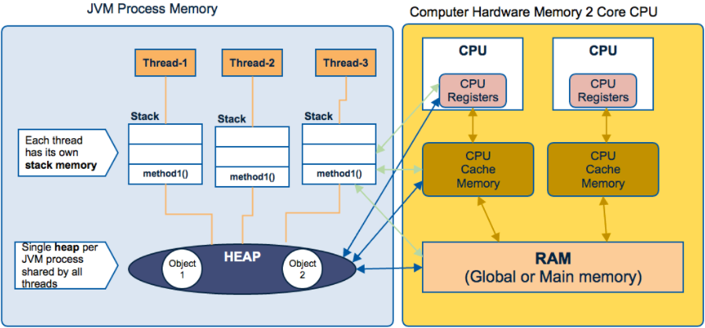
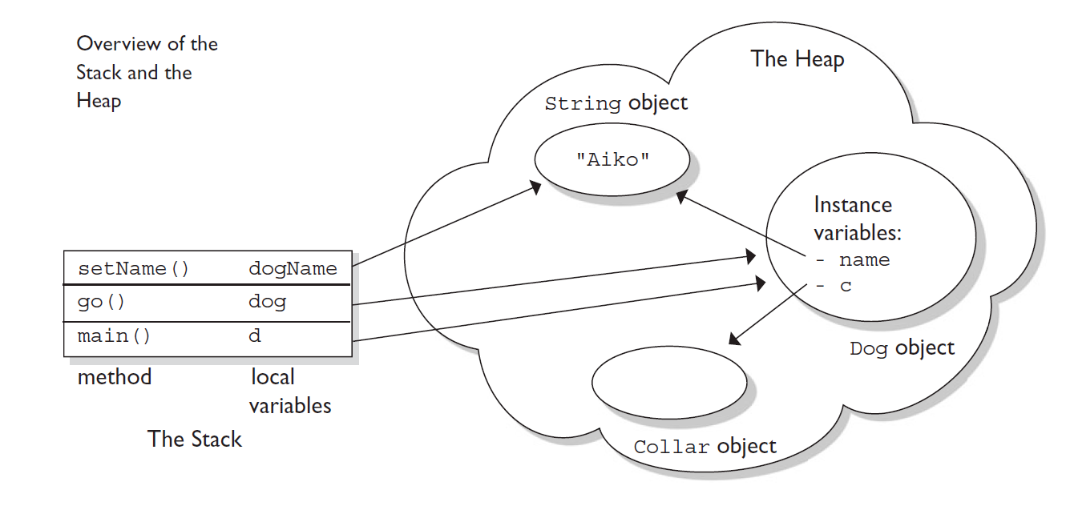
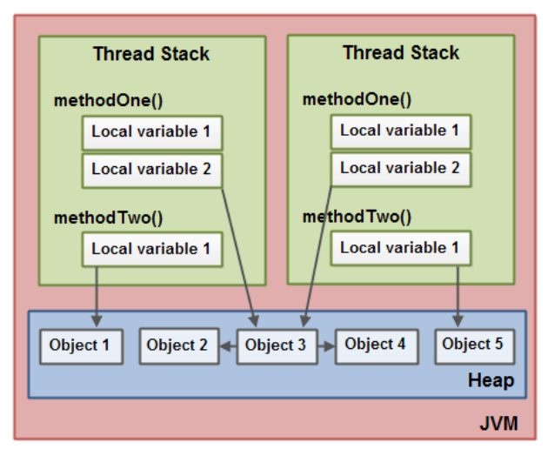
Where Storage Lives
Hardware memory architecture:
Registers – fastest storage
The Stack – in RAM
Static Storage - (fixed) in RAM
Constant Storage - ROM
Non-RAM Storage (persistence)
The hardware memory architecture does not distinguish between thread stacks and heap. On the hardware, both the thread stack and the heap are located in main memory.
CODE: WhereStorageLives.java
Instance variables and objects live on HEAP
Methods and Local (automatic/stack/method) vars. live on STACK, but its referencing object or created object live on STACK
Note: local variables created on stack whereas Instance variables created on HEAP
When objects and variables can be stored in various different memory areas in the computer,
certain problems may occur. The two main problems are:
Visibility of thread updates (writes) to shared variables.
Race conditions when reading, checking and writing shared variables. See multithreading blog
Notes:
Modern hardware memory architecture is somewhat different from the internal Java memory model. It is important to understand the hardware memory architecture too, to understand how the Java memory model works with it.
The hardware memory architecture does not distinguish between thread stacks and heap. On the hardware, both the thread stack and the heap are located in main memory.
As already mentioned, the Java memory model and the hardware memory architecture are different.
The hardware memory architecture does not distinguish between thread stacks and heap.
On the hardware, both the thread stack and the heap are located in main memory.
Parts of the thread stacks and heap may sometimes be present in CPU caches and in internal CPU registers.
When objects and variables can be stored in various different memory areas in the computer, certain problems may occur. The two main problems are:
- Visibility of thread updates (writes) to shared variables.
- Race conditions when reading, checking and writing shared variables.
Registers – fastest storage
The Stack – in RAM
Static Storage - (fixed) in RAM
Constant Storage - ROM
Non-RAM Storage (persistence)
Visibility of Shared Objects
If two or more threads are sharing an object, without the proper use of either volatile declarations or synchronization, updates to the shared object made by one thread may not be visible to other threads
Also, HAPPENS BEFORE GUARANTEE, ……
All local variables of primitive types ( boolean, byte, short, char, int, long, float, double) are fully stored on the thread stack and are thus not visible to other threads.
Before Java 8, PermGen stores static members like static methods and static variables. Additionally, PermGen also stores interned strings.
Permanent Generation (Replaced by Metaspace since Java 8)
Memory management is a crucial element in many types of applications. Java's garbage collector provides an automatic solution to memory management.
The heap is that part of memory where Java objects live, and it's the one and only part of memory that is in any way involved in the garbage collection process.
When the garbage collector runs, its purpose is to find and delete objects that cannot be reached.
If you think of a Java program as being in a constant cycle of creating the objects it needs (which occupy space on the heap), and then discarding them when
they're no longer needed, creating new objects, discarding them, and so on, the missing piece of the puzzle is the garbage collector.
Just as the local variable starts its life inside the method, it's also destroyed when the method has completed.
Primitive variables can be declared as class variables (statics), instance variables, method parameters, or local variables.
Primitive types declared locally will be on the stack while primitive types that are defined as part of an object instance are stored on the heap.
Local variables are stored on stack while instance and static variables are stored on the heap.
It’s useful to visualize some aspects of how things are laid out while the program is running—in particular how memory is arranged. There are six different places to store data:
Registers. This is the fastest storage because it exists in a place different from that of other storage: inside the processor. However, the number of registers is
severely limited, so registers are allocated by the compiler according to its needs. You don’t have direct control, nor do you see any evidence in your programs that registers even exist.
The stack. This lives in the general random-access memory (RAM) area, but has direct support from the processor via its stack pointer. The stack pointer is moved down to create new memory and moved up to release that memory. This is an extremely fast and efficient way to allocate storage, second only to registers. The Java compiler must know, while it is creating the program, the exact size and lifetime of all the data that is stored on the stack, because it must generate the code to move the stack pointer up and down. This constraint places limits on the flexibility of your programs, so while some Java storage exists on the stack—in particular, object references—Java objects themselves are not placed on the stack. The heap. This is a general-purpose pool of memory (also in the RAM area) where all Java objects live. The nice thing about the heap is that, unlike the stack, the compiler doesn’t need to know how much storage it needs to allocate from the heap or how long that storage must stay on the heap. Thus, there’s a great deal of flexibility in using storage on the heap. Whenever you need to create an object, you simply write the code to create it by using new, and the storage is allocated on the heap when that code is executed. Of course there’s a price you pay for this flexibility. It takes more time to allocate heap storage than it does to allocate stack storage (if you even could create objects on the stack in Java, as you can in C++).
Static storage. “Static” is used here in the sense of “in a fixed location” (although it’s also in RAM). Static storage contains data that is available for the entire time a program is running. You can use the static keyword to specify that a particular element of an object is static, but Java objects themselves are never placed in static storage.
Constant storage. Constant values are often placed directly in the program code, which is safe since they can never change. Sometimes constants are cordoned off by themselves so that they can be optionally placed in read-only memory (ROM), in embedded systems.
Non-RAM storage. If data lives completely outside a program, it can exist while the program is not running, outside the control of the program. The two primary examples of this are streamed objects, in which objects are turned into streams of bytes, generally to be sent to another machine, and persistent objects, in which the objects are placed on disk so they will hold their state even when the program is terminated. The trick with these types of storage is turning the objects into something that can exist on the other medium, and yet can be resurrected into a regular RAM-based object when necessary. Java provides support for lightweight persistence, and future versions of Java might provide more complete solutions for persistence. Special case: primitive types One group of types, which you’ll use quite often in your programming, gets special treatment. You can think of these as “primitive” types. The reason for the special treatment is that to create an object with new—especially a small, simple variable—isn’t very efficient, because new places objects on the heap. For these types Java falls back on the approach taken by C and C++. That is, instead of creating the variable by using new, an “automatic” variable is created that is not a reference. The variable holds the value, and it’s placed on the stack, so it’s much more efficient.
Java determines the size of each primitive type. These sizes don’t change from one machine architecture to another as they do in most languages. This size invariance is one reason Java programs are portable.

Slide 4

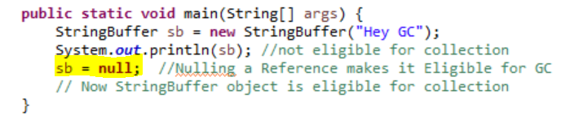
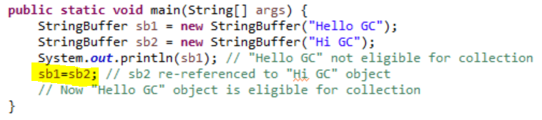
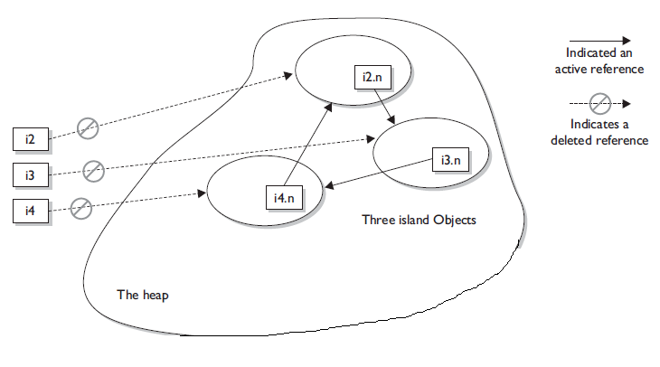
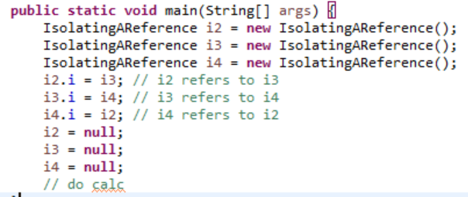
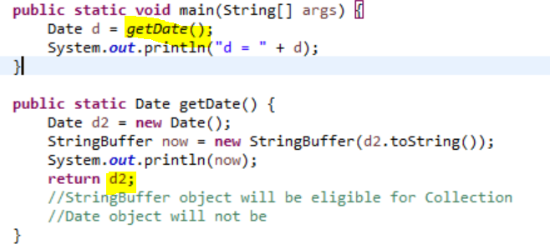
Java Garbage Collector
Can we force to run GC?
Java's garbage collector provides an automatic solution to memory management.
Garbage collection cannot ensure that there is enough memory, only it manages available memory as efficiently as possible.
The garbage collector is under the control of the JVM. The JVM decides when to run the garbage collector.
JVM will typically run the garbage collector when it senses that memory is running low.
It tracks each and every object available in the JVM heap space and removes unused ones.
You can only ask [System.gc()] for GC (can’t force) but no guarantee when it happens.
Pros: Automatic memory management (compare by C/C++..) . Cons: Managed by JVM. Stop the World issue. Not like man-mem-efficiency
An object is eligible for garbage collection when can't be reached by any live thread
CODE: Memory Alloc. – GC illustration via addr of Obj using Unsafe by Sun.
When Objects are Eligible for Collection?
Once Garbage collector runs, it can discover those objects and delete them.
Nulling a Reference
Reassigning a Reference Variable
Once method call is over BUT …
Islands of Isolation //self
.. ? //pools (interning), caches, …
Notes:
https://www.baeldung.com/java-permgen-metaspace
The JVM keeps track of loaded class metadata in the PermGen. Additionally, the JVM stores all the static content in this memory section. This includes all the static methods, primitive variables, and references to the static objects.
Java Garbage Collection is the process to identify and remove the unused objects from the memory and free space to be allocated to objects created in future processing. One of the best features of Java programming language is the automatic garbage collection, unlike other programming languages such as C where memory allocation and deallocation is a manual process.
Garbage Collector is the program running in the background that looks into all the objects in the memory and find out objects that are not referenced by any part of the program. All these unreferenced objects are deleted and space is reclaimed for allocation to other objects.
A garbage collector is a form of automatic memory management where a runtime like JVM manages allocation and reclamation of memory for the user programs running on it. There are several algorithms to implement a garbage collector. These include reference counting, mark-sweep, mark-compact, and copying.
The former achieves higher throughput at the cost of high latency due to long pauses, also known as stop-the-world pauses. The latter aims for better latency but compromises on throughput.
Unsafe - from the sun.misc package. This class provides us with low-level mechanisms that were designed to be used only by the core Java library and not by standard users.
Can a Java application run out of memory? Yes. The garbage collection system attempts to remove objects from memory when they are not used.
However, if you maintain too many live objects (objects referenced from other live objects), the system can run out of memory.
Garbage collection cannot ensure that there is enough memory, only that the memory that is available will be managed as efficiently as possible.
Objects in method. When a method is invoked, any local variables created exist only for the duration of the method. Once the method has returned, the objects created in the method are eligible for garbage collection.
BUT… If an object is returned from the method, in case referenced to other variable in the method call; hence, it will not be eligible for collection
Isolating a Reference
There is another way in which objects can become eligible for garbage collection, even if they still have valid references! We call this scenario "islands of isolation."
A simple example is a class that has an instance variable that is a reference variable to another instance of the same class. Now imagine that two such instances
exist and that they refer to each other. If all other references to these two objects are removed, then even though each object still has a valid reference, there will be
no way for any live thread to access either object. When the garbage collector runs, it can usually discover any such islands of objects and remove them. As you can
imagine, such islands can become quite large, theoretically containing hundreds of objects. Examine the following code:
Cleaning Up Before Garbage Collection—the finalize() Method
So, any code that you put into your class's overridden finalize() method is not guaranteed to run..
Let's look into these statements a little further. First of all, remember that any
code that you can put into a normal method you can put into finalize(). For
example, in the finalize() method you could write code that passes a reference
to the object in question back to another object, effectively uneligiblizing the object
for garbage collection.
POOLS/CACHES --- Use JAVA REGERNCES, … soft, weak, phantom refernces, …
https://www.baeldung.com/java-string-pool
the special memory region where Strings are stored by the JVM.
Thanks to the immutability of Strings in Java, the JVM can optimize the amount of memory allocated for them by storing only one copy of each literal String in the pool. This process is called interning.
Before Java 7, the JVM placed the Java String Pool in the PermGen space, which has a fixed size — it can't be expanded at runtime and is not eligible for garbage collection.
The risk of interning Strings in the PermGen (instead of the Heap) is that we can get an OutOfMemory error from the JVM if we intern too many Strings.
From Java 7 onwards, the Java String Pool is stored in the Heap space, which is garbage collected by the JVM. The advantage of this approach is the reduced risk of OutOfMemory error because unreferenced Strings will be removed from the pool, thereby releasing memory.

Slide 5
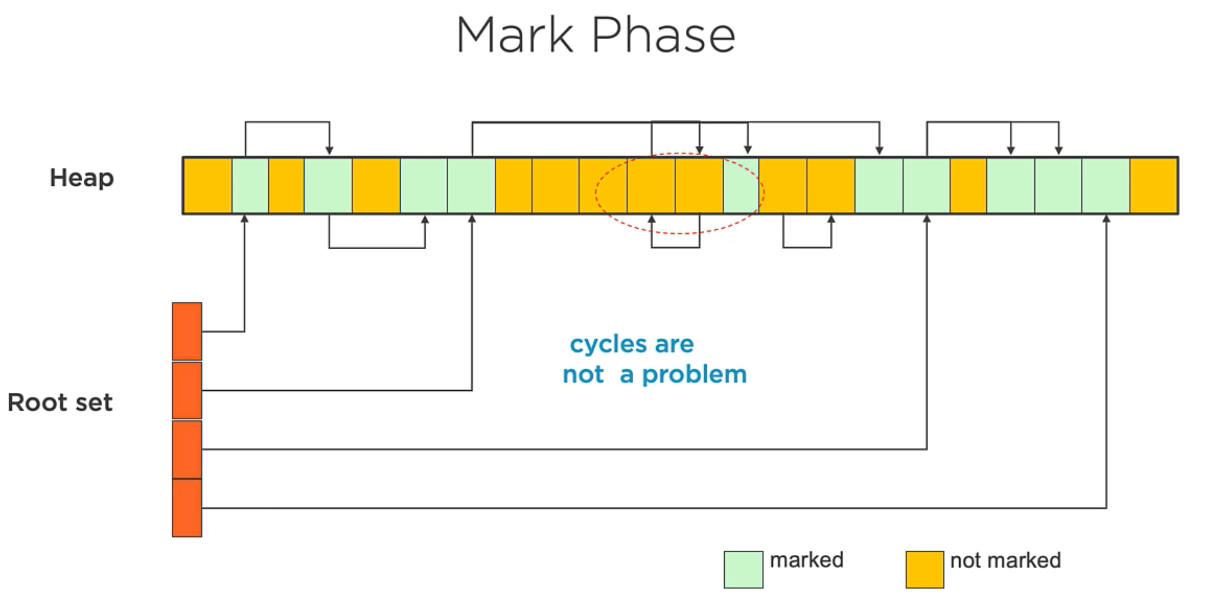
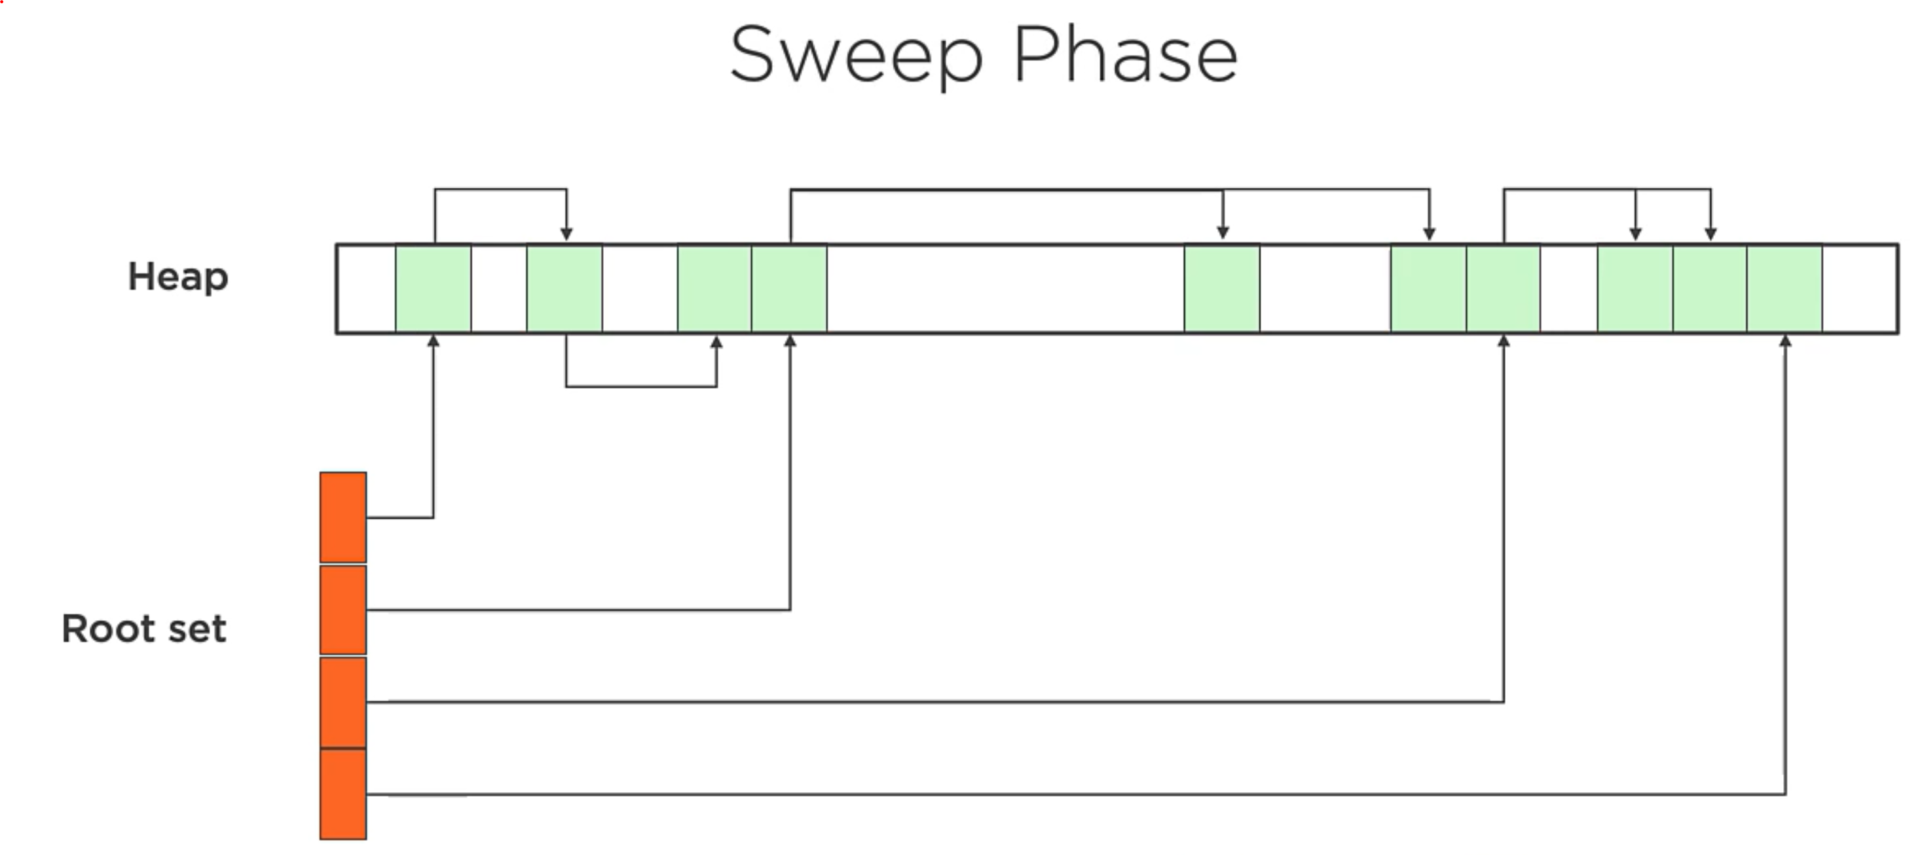
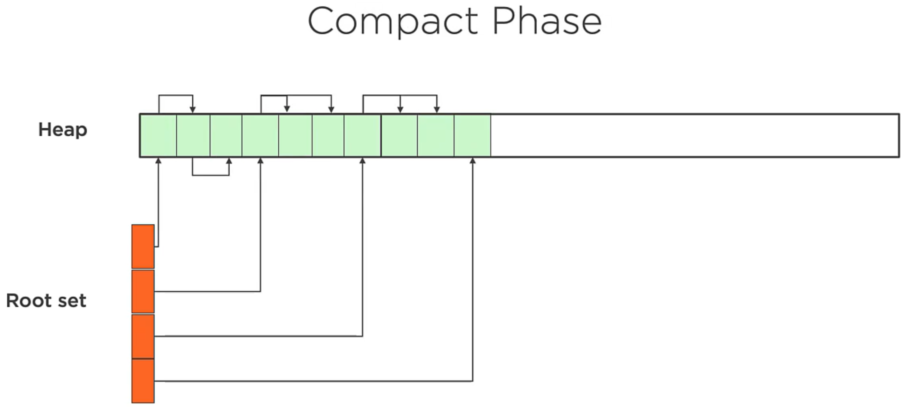
Types of Garbage Collection
Reference Counting – Count inc. once object started to be referenced, decreased until zero and become eligible for GC. Issue with circular ref. It happens when one object refers to another, and that other one refers to the first object.
Mark and Sweep – “mark” phase identifies the objects are still in being used, “sweep” phase removes un-used objs. “compact” phase defragments the memory.
Mark and Sweep
Notes:
Do Nothing – never run, not collects live objects
Reference Counting - issue with circular references.
Compact phase changes the physical address of the memory.
JVM internally gets physical address of the memory.
One of the basic ways of garbage collection involves three steps:
Marking: This is the first step where garbage collector identifies which objects are in use and which ones are not in use.
Normal Deletion: Garbage Collector removes the unused objects and reclaim the free space to be allocated to other objects.
Deletion with Compacting: For better performance, after deleting unused objects, all the survived objects can be moved to be together. This will increase the performance of allocation of memory to newer objects.
There are two problems with a simple mark and delete approach.
First one is that it’s not efficient because most of the newly created objects will become unused
Secondly objects that are in-use for multiple garbage collection cycle are most likely to be in-use for future cycles too.

Slide 6
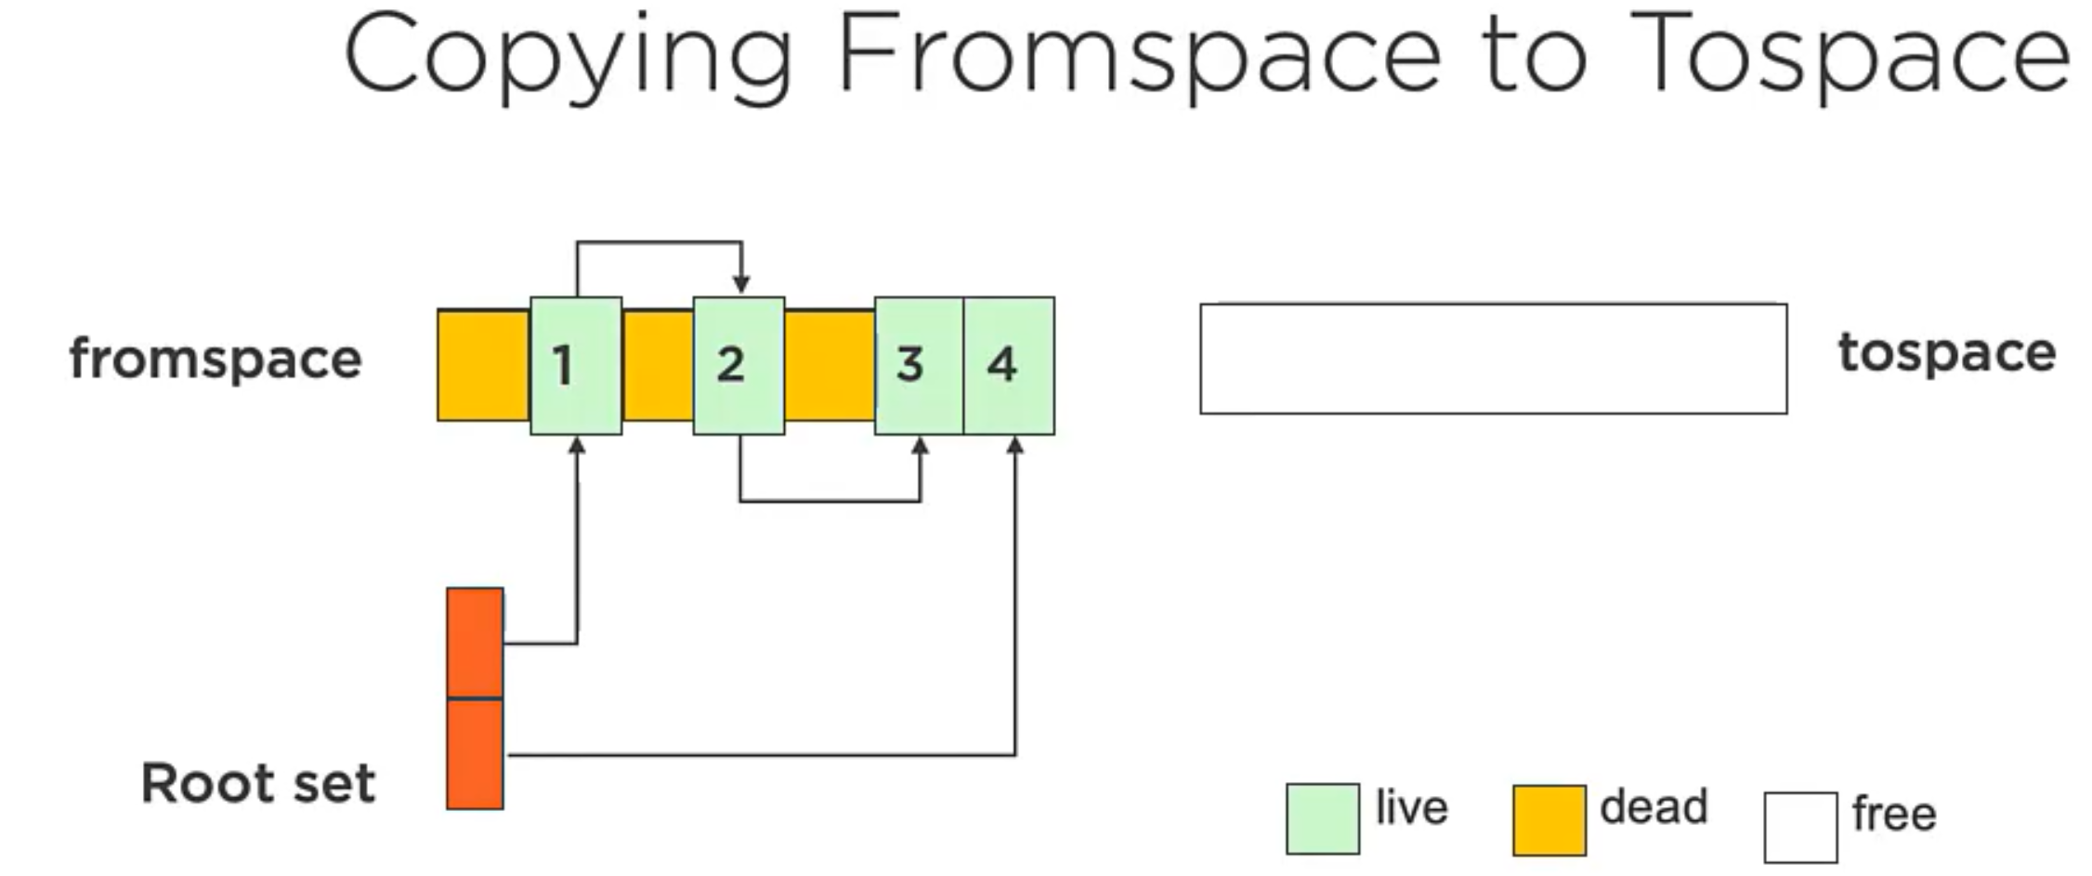
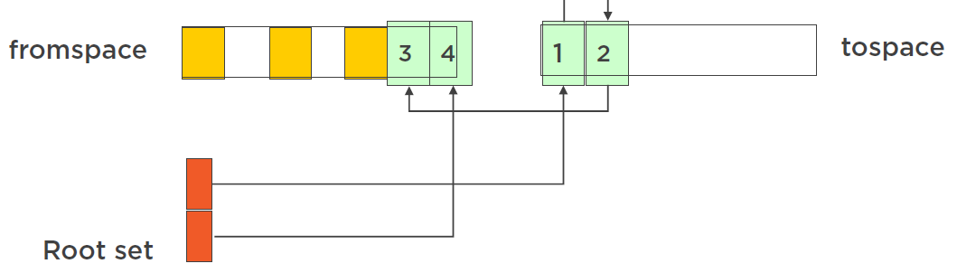
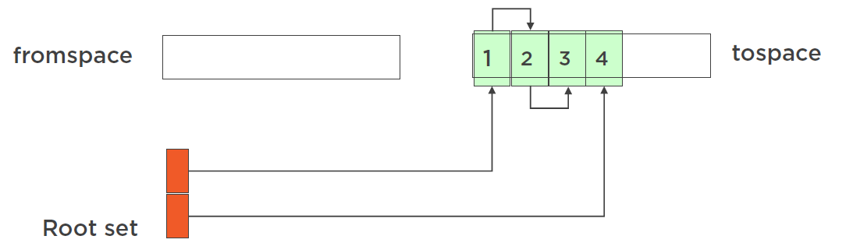
Types of Garbage Collection
Copying – mark & sweep happens but uses different spaces to manage the memory. During copying memory is compacted at the same time, and from space is cleared after all live objects are moved.
Generational – Manages different generations for memory, long living objects (survived) are promoted to diff-gen. Sweeps happen more often in young generations than old one.
Incremental – does not scan all the memory all the time.
Copying
Notes:
Two spaces are now swapped. So again, new objects are allocated to fromspace, and it copying started to happen again, …
https://en.wikipedia.org/wiki/Compare-and-swap
UnSafe Class….. https://www.baeldung.com/java-unsafe
The allocateMemory() method from the Unsafe class gives us the ability to allocate huge objects off the heap, meaning that this memory will not be seen and taken into account by the GC and the JVM.

Slide 7
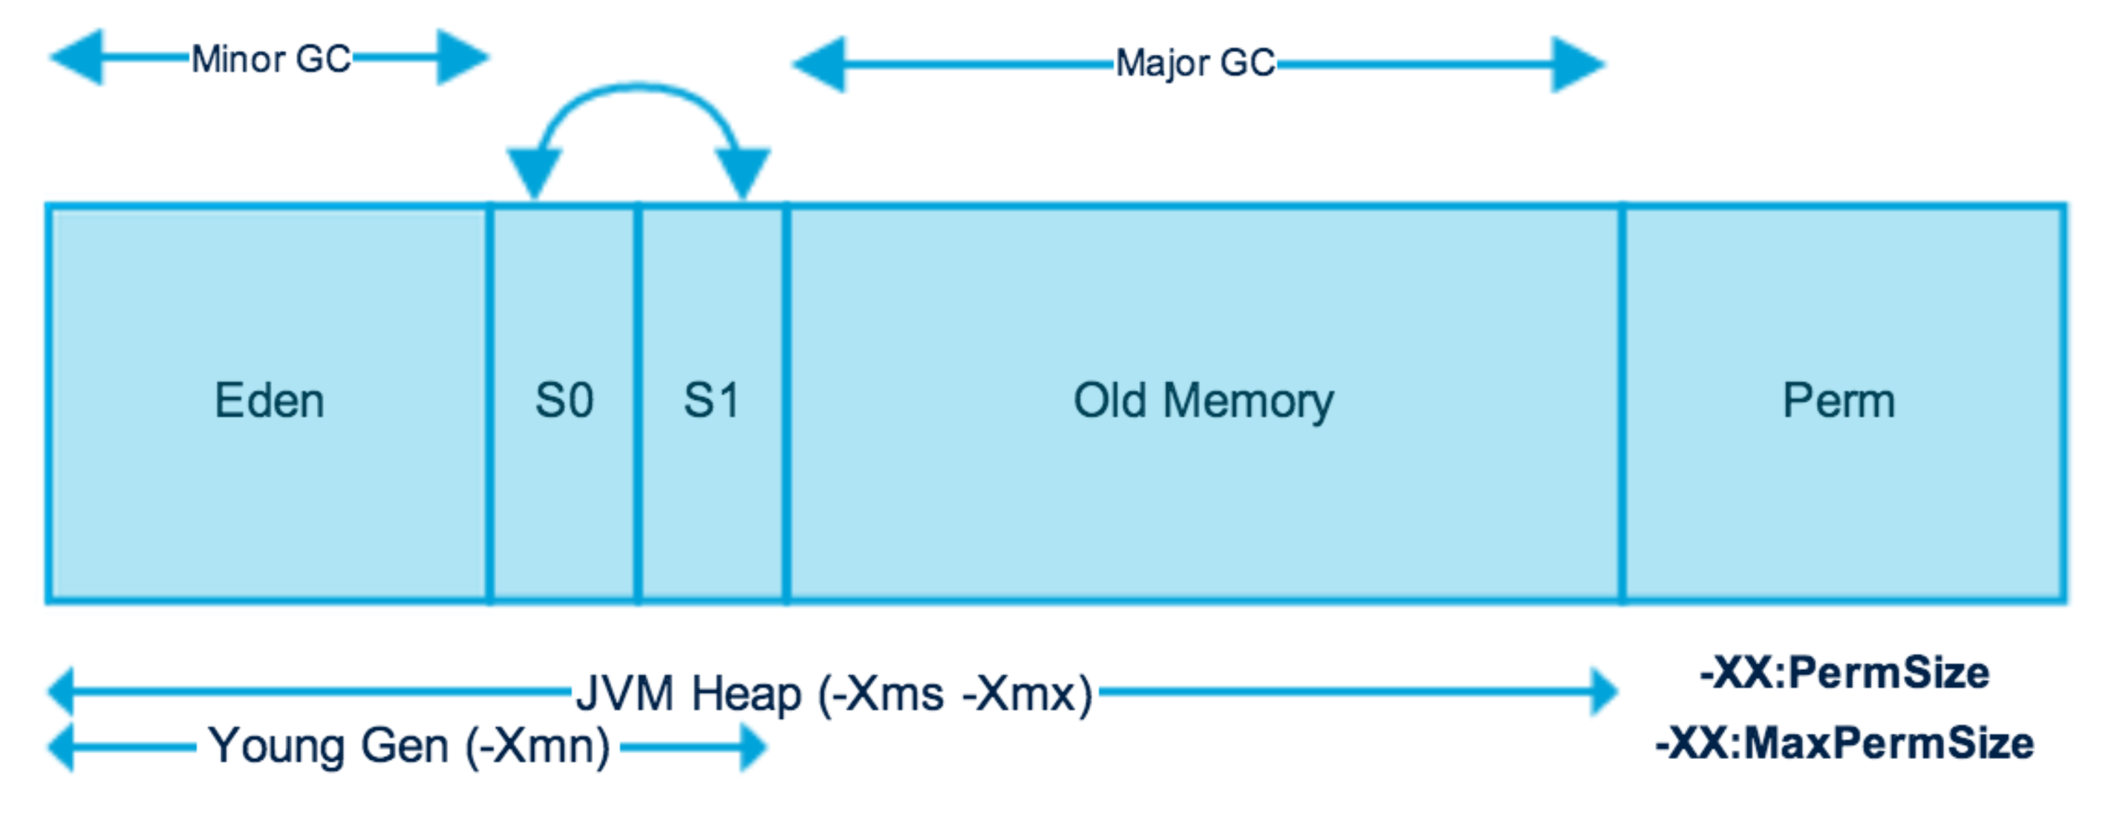
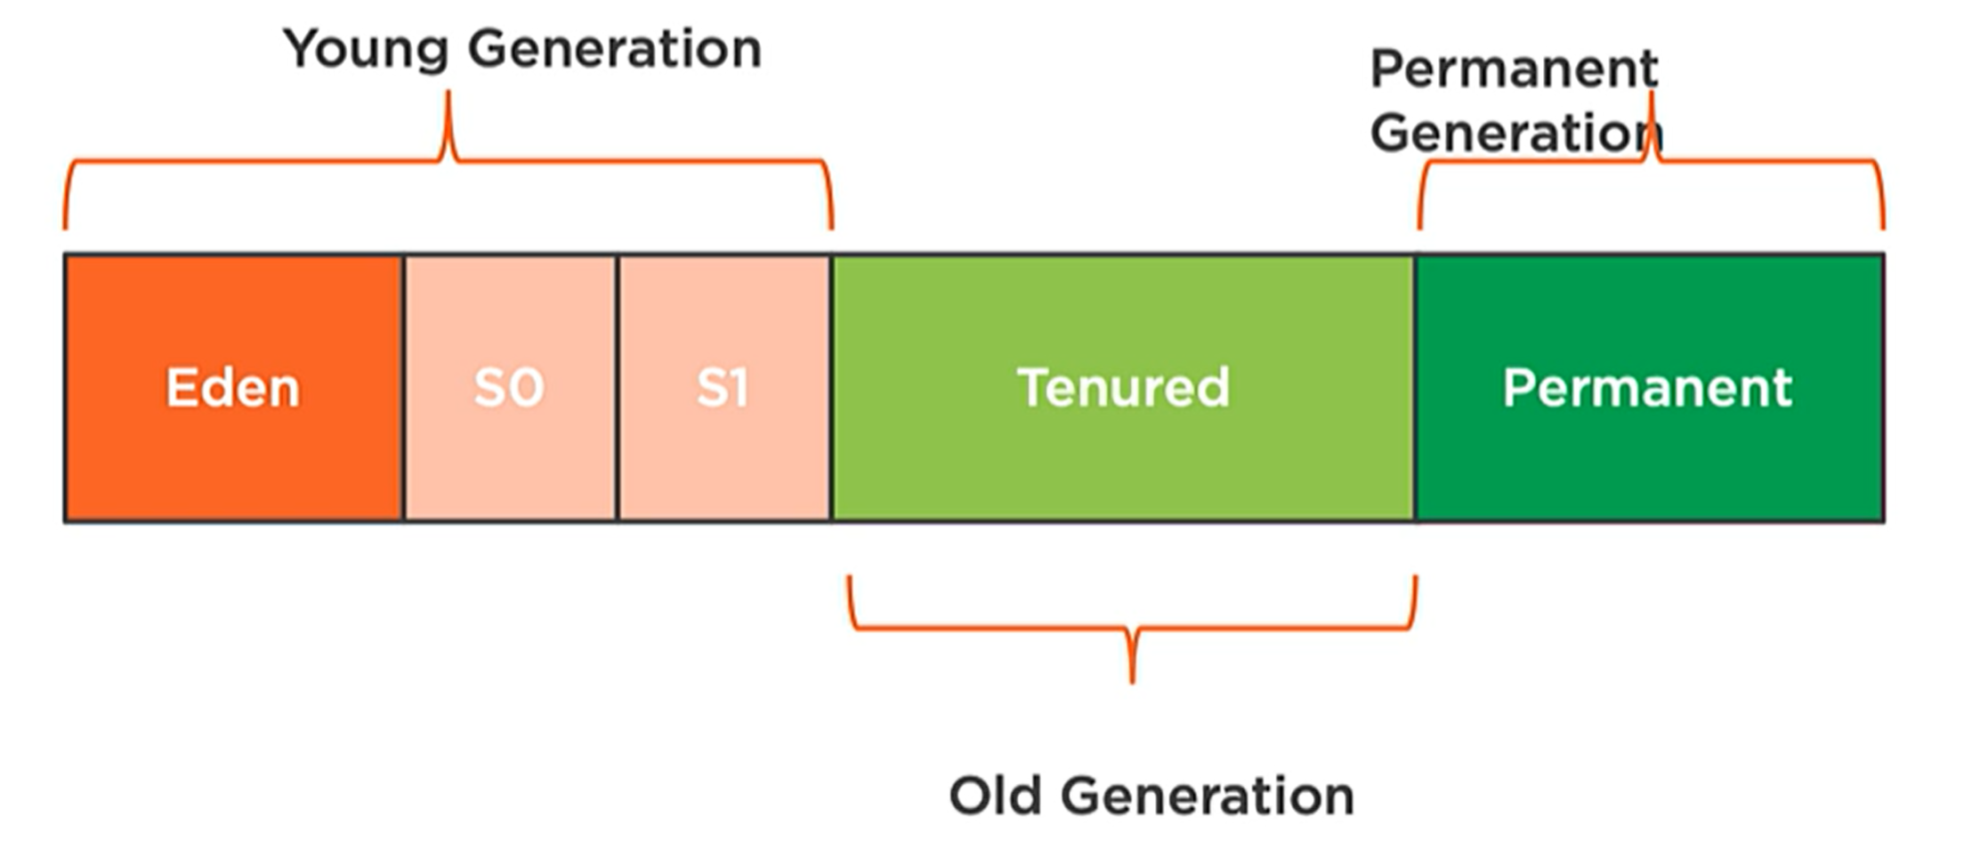
Java Memory Model
Memory space is broken into two spaces: Young and Old (Tenured Space) Generations.
The JVM internally separates the Young Generation into Eden and Survivor Spaces (S0, S1).
Newly allocated objects are going to Eden [Eden Gardens] space.
Objects survived in young generation promoted to one of Survivor spaces.
One survivor space is used at a time, and objects are copied between survivor spaces
Old generation where long lived objects (survived many times) live (most stable objects, .. )
GC runs frequently on Young Gen. So motto is: die young or live forever.
Permanent space (never GC run here) – used by Java Runtime (class info stored, )
Notes:
Throughput – how quickly can it run, how quickly can it collect the garbage
https://www.betsol.com/blog/java-memory-management-for-java-virtual-machine-jvm/
Java Memory Model – Permanent Generation
Permanent Generation or “Perm Gen” contains the application metadata required by the JVM to describe the classes and methods used in the application. Note that Perm Gen is not part of Java Heap memory.
Perm Gen is populated by JVM at runtime based on the classes used by the application. Perm Gen also contains Java SE library classes and methods. Perm Gen objects are garbage collected in a full garbage collection.
Java Memory Model – Memory Pool
Memory Pools are created by JVM memory managers to create a pool of immutable objects if the implementation supports it.
String Pool is a good example of this kind of memory pool.
Memory Pool can belong to Heap or Perm Gen, depending on the JVM memory manager implementation.
Java Memory Model – Runtime Constant Pool
Runtime constant pool is per-class runtime representation of constant pool in a class. It contains class runtime constants and static methods. Runtime constant pool is part of the method area.
Java Memory Model – Method Area
Method Area is part of space in the Perm Gen and used to store class structure (runtime constants and static variables) and code for methods and constructors.
JVM Heap memory is physically divided into two parts – Young Generation and
The young generation is the place where all the new objects are created. When the young generation is filled, garbage collection is performed. This garbage collection is called Minor GC. Young Generation is divided into three parts – Eden Memory and two Survivor Memory spaces.Old Generation.
Stop the World Event
All the Garbage Collections are “Stop the World” events because all application threads are stopped until the operation completes.
Since Young generation keeps short-lived objects, Minor GC is very fast and the application doesn’t get affected by this.
However, Major GC takes a long time because it checks all the live objects. Major GC should be minimized because it will make your application unresponsive for the garbage collection duration. So if you have a responsive application and there are a lot of Major Garbage Collection happening, you will notice timeout errors.

Slide 8
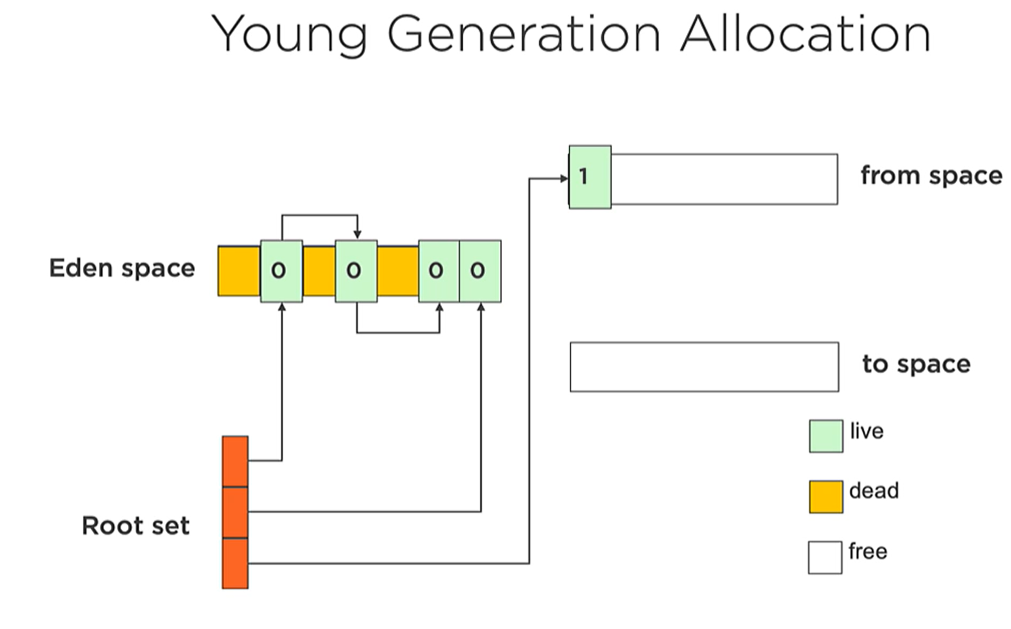
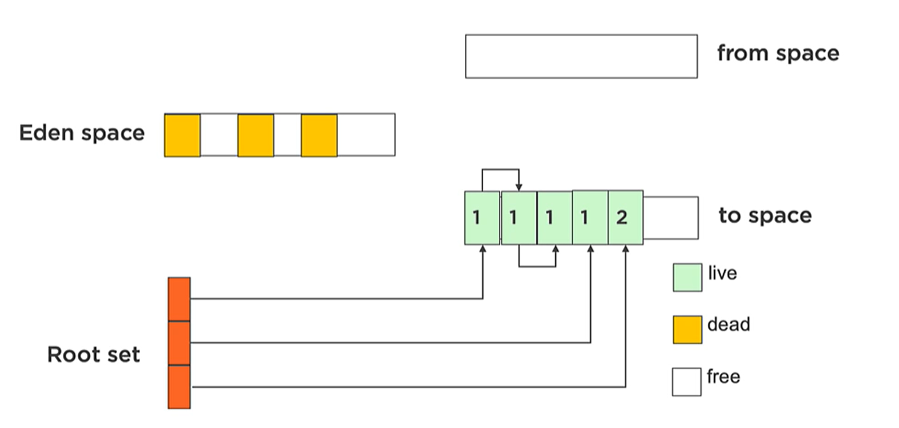
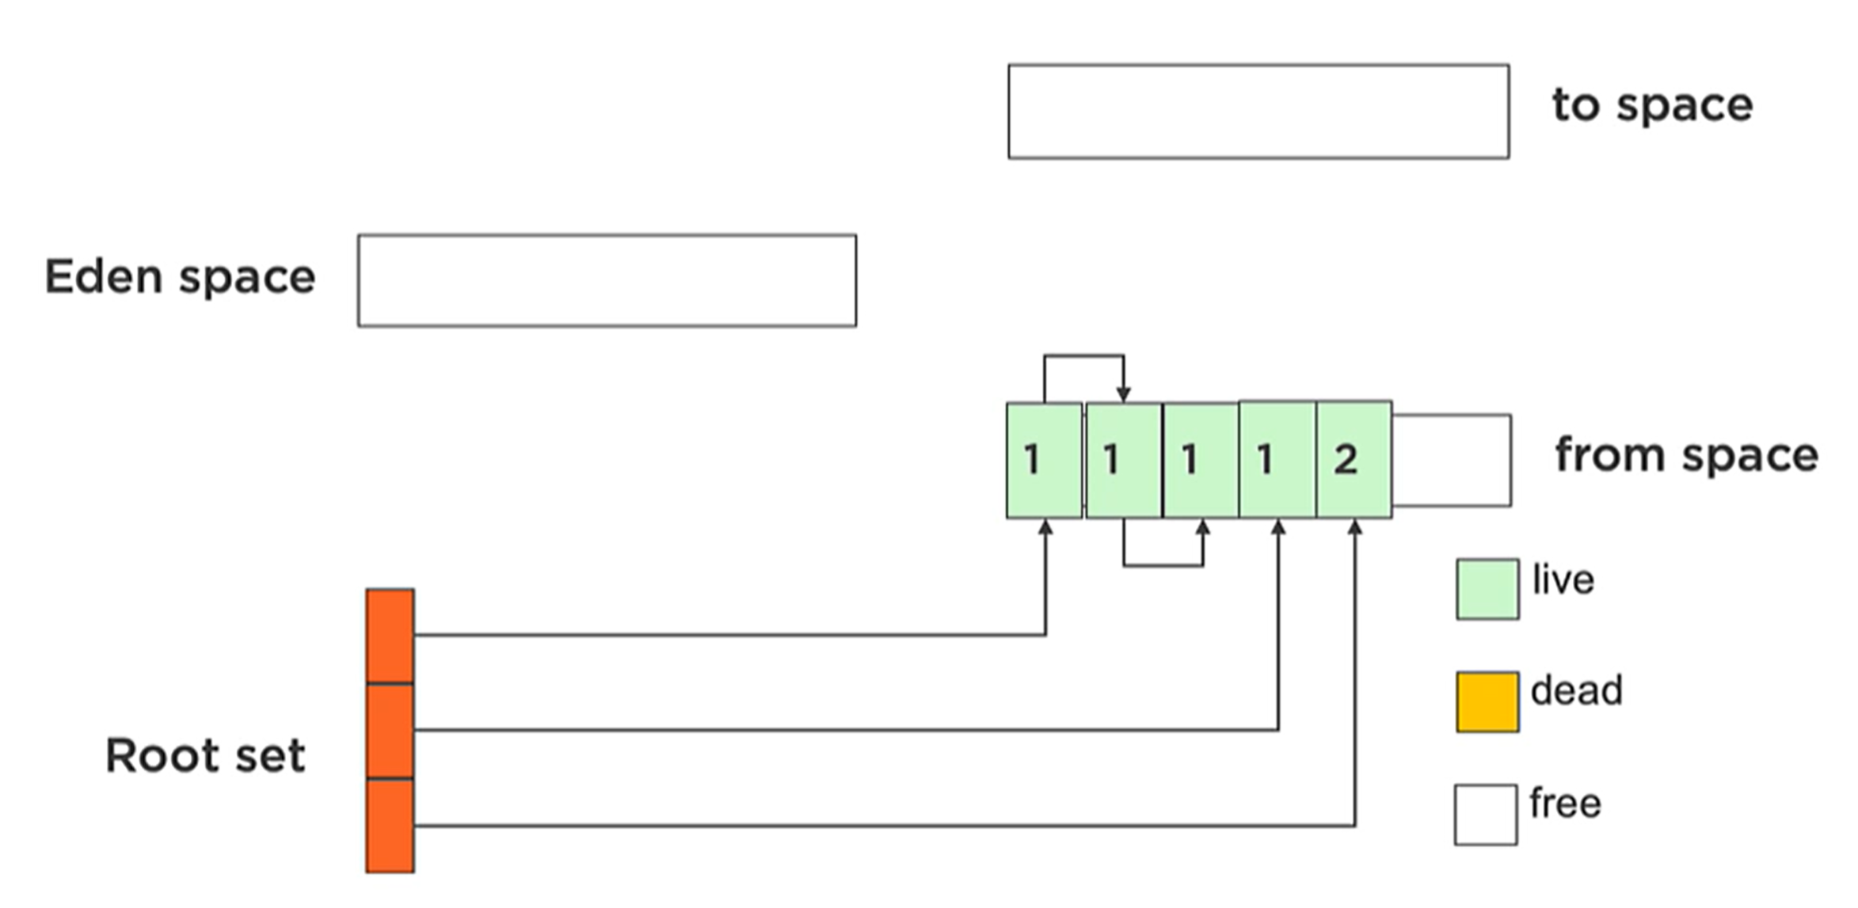
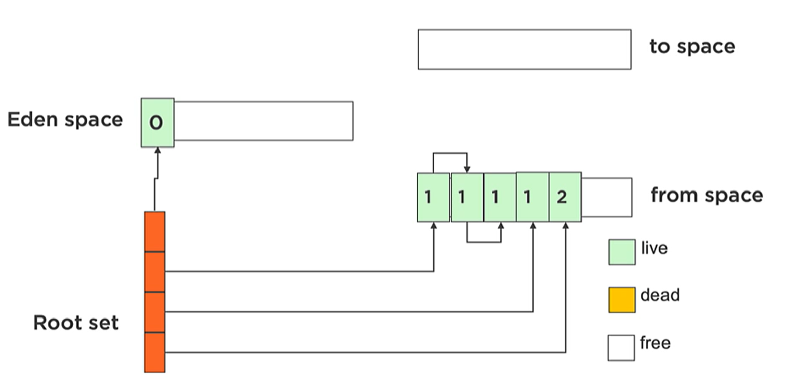
How Garbage Collection Works - Minor GC
Minor GC happens when the Young Generation is FULL, happens more frequently.
New objects are allocated to Eden space. Initial survivor space is called ‘from space’
When GC runs (Minor GC happens), objects are copied to newer survivor space, eden is cleared, and surviver spaces will be swapped
Notes:
When Minor GC happens, it marks the objects, and move them to new survivor space.
And also initial survivor space (from space) will be copied to ‘to space’. As you see it keeps number, how many times SURVIVED.
So ‘0’ zero survived, once copied it goes to ‘1’. And above ‘1’ will be ‘2’, so two times survived
Then Eden space is removed, and again start to allocate new objects.
And surviver spaves will be swapped.

Slide 9
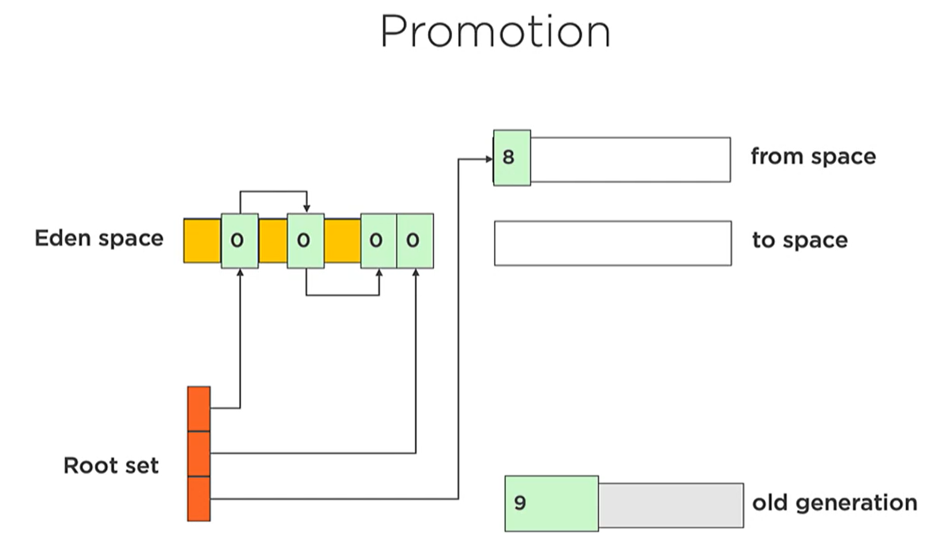
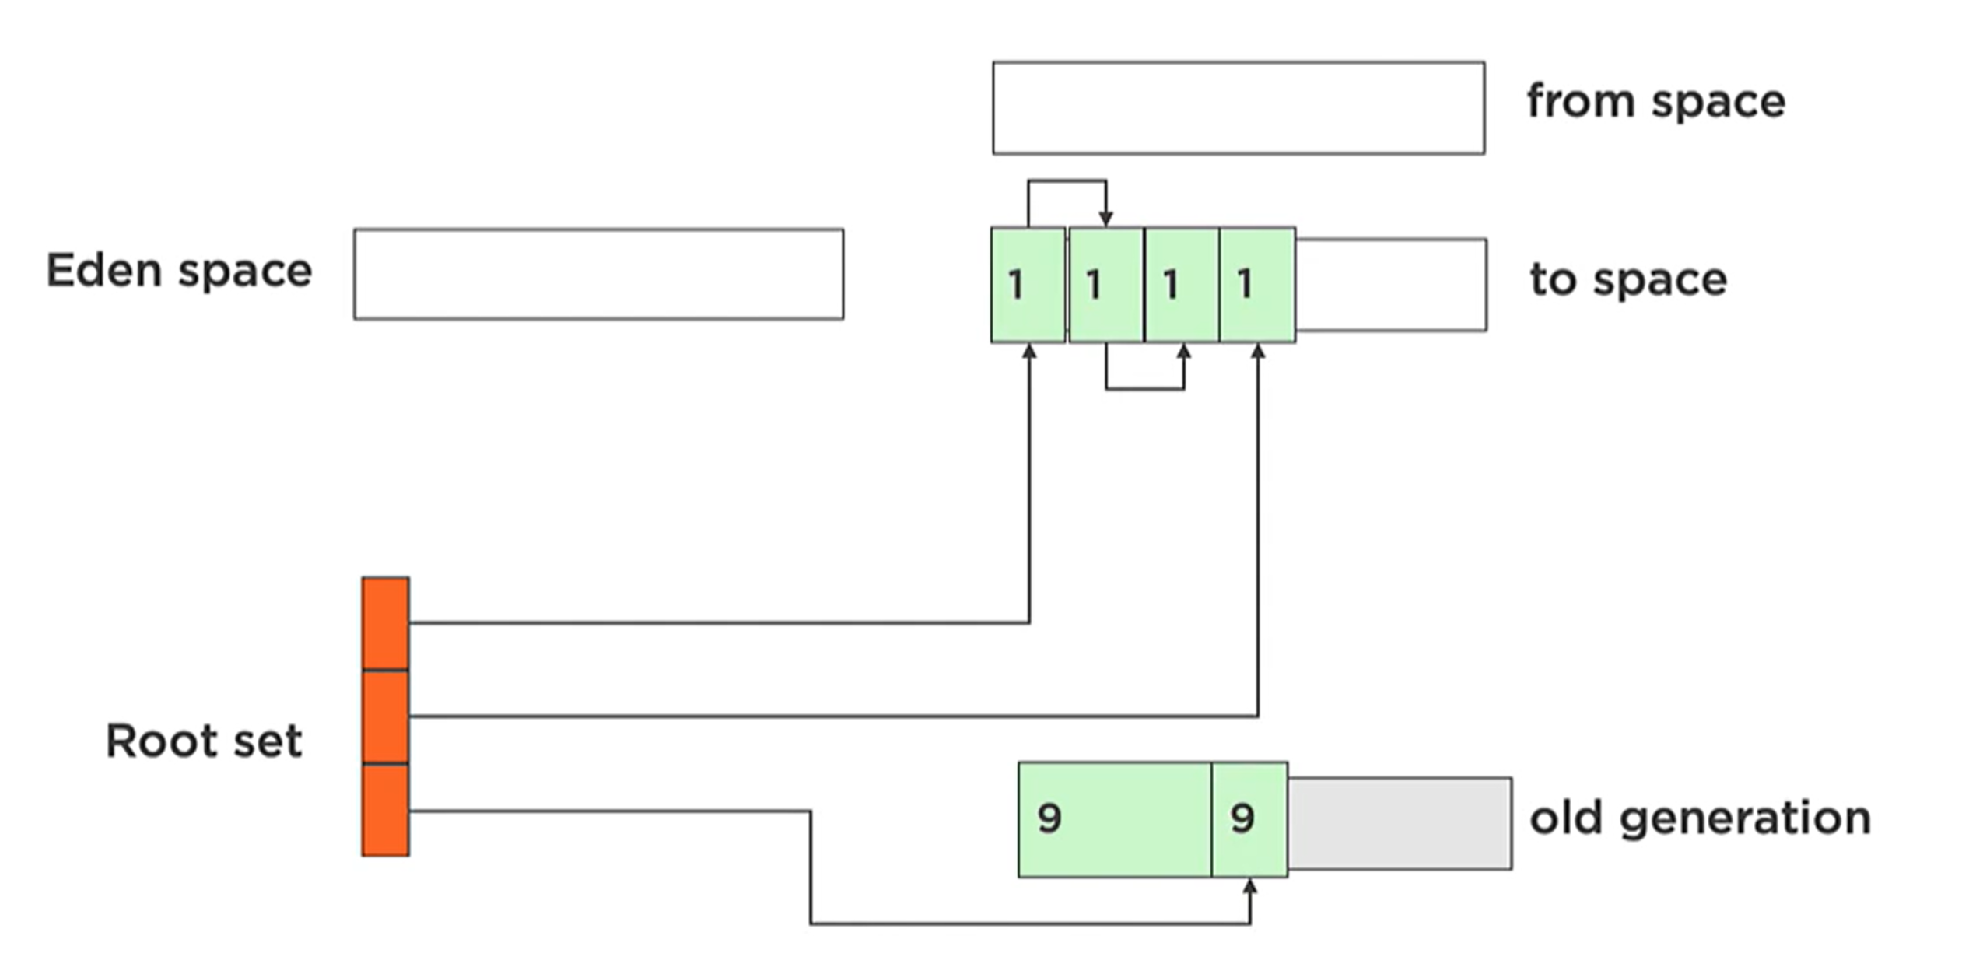
How Garbage Collection Works – Major GC, Full GC
Major GC triggered when tenured (Old Generation) is FULL. Happens less frequently. It is slower than Minor GC
Full GC - Collects OLD and YOUNG gen. at the same time (on Oracle Java VM)
In Major CG memory is copied from Young to Old generation – called promotion
after survived several times
once survivor space is full.
Or JVM has been told, create object in Old space (via JVM flag set: -XX:+AlwaysTenure )
Allocating Objects to Old Space
Objects with certain size can be directly allocated to Old space. There is no JVM flag for this to allocate always.
But can be done via: -XX:PretenureSizeThreshold=<n> if objSize>n then objects allocated to Old gen. If object size fits to TLAB, then JVM allocates it into TLAB (Thread Local Allocation Buffer).
Notes:
In the beginning we have objects in Eden space, and survived 8 times object in SURVIVER space. And also, long-live objects (survived 9 times, and promoted already)
When we run the GC (Major GC happens, because objects ‘8’ will be survived ‘9’ times, and it will be promoted to OLD generation)
What is TLAB - https://dzone.com/articles/thread-local-allocation-buffers
https://docs.oracle.com/cd/E13209_01/wlcp/wlss30/configwlss/jvmgc.html
TLAB stands for Thread Local Allocation Buffer and it is a region inside Eden, which is exclusively assigned to a thread.
In other words, only a single thread can allocate new objects in this area. Each thread has own TLAB.
Thanks to that, as long as objects are allocated in TLABs, there is no need for any type of synchronization.
Allocation inside TLAB is a simple pointer bump (that’s why it’s sometimes called pointer bump allocation) — so, the next free memory address is used.
Memory ALLOCATION in Java. Just use POINTER, and allocate OBJECT and move it forward.
Moving pointer is very CHEAP Operation and VERY QUCIK way of allocating MEMORY.
Easy for SINGLE thread-env. How on multi-thread env.?
Threads, multiple PINTERS, will compete on same peace of memory, ….. Involves LOCKs, and they are EXPENSIVE.
So in JAVA we use TLAB (Thread Local Allocation Buffer)
Each thread gets its own buffer in Eden space. And THREADS can ALLOCATE into THAT BUFFER.
So no locking required, and it makes allocation VERY QUICK>
--------
Live roots (references) - from stack frames, static (global) variable, JNI, monitors, … . References from live-rooted objects are followed to other objects. GC will not destroy those live objects.
What about references from old generation to young? So we need to keep that object in Young generation live (not destroy).
Issue is Young GC (Minor GC) has to scan Old space. Normally it looks only references in Young gen. (Eden space)
Fix: Use “card tables”
Live roots?
From Stack FRAMES
Static variables
JNI, and sy
Issue is – you need to to FULL GC, load to memory, SCAN, al lot work… - this simply BREAKS have multiple generations, ….. So no need, …
Solution is CARD TABLE
Per entry 512 bytes
On minor GC CARD TABLE is scanned and if refereces are the then OBJECTS will not removed
Card Tables
----------
Each write to a reference to a young object
goes through a write barrier
This barrier updates a card table entry
One entry per 512 bytes of memory
Minor GC scans table looking for the areas
that contain references
Load that memory and follow the reference

Slide 10
Garbage Collectors Implementations
Which GC to choose? Consider: Stop the world events (1), memory fragmentation(2), Throughput(3). And profile (via mxbean, jstat, visualgc) the app. As close to production load.
Serial Garbage Collector – simplest GC impl., works with a single thread (1) :
>java -XX:+UseSerialGC -jar App.java
Good for apps. that do not have small pause time req. and to run on client-style machines.
Parallel [Parallel GC, Parallel Old GC] Garbage Collector – also called Throughput Collector (3). Uses multiple threads for managing heap space. Mostly used in production servers.
Parallel for MinorGC and serial (1) for MajorGC -XX:+UseParallelGC, and parallel for both -XX:+UseParallelOldGC.
Tune max. gc. threads and pause time, throughput, and footprint (heap size). Max-pause-goal: -XX:MaxGCPauseMillis=<N>
CMS Garbage Collector (low latency) – Deprecated in Java 9, removed in 14. Concurrent Mark Sweep uses multiple garbage collector threads for gc. designed for apps. in need shorter gc. pauses, throughput is higher …
–XX:+UseConcMarkSweepGC , –XX:-UseParNewGC. With serial (1) young space collector
–XX:+UseConcMarkSweepGC , –XX:+UseParNewGC. With parallel young space collector
We can limit the number of threads in CMS collector using –XX::ParallelCMSThreads=<n> JVM option.
Java 8 JVM has new param – Optimizing heap-memory for reducing the unnecessary use of memory by creating too many instances of the same String. > -XX:+UseStringDeduplication
Notes:
Parallel Garbage Collector is also called throughput collector because it uses multiple CPUs to speed up the GC performance
The second one (UseParNewGC) gets activated automatically with the concurrent tenured generation garbage collection
Throughput – how quickly can it run, how quickly can it collect the garbage.
Use profiling with data load close to production, and test it with different CG (use JVM params and flags) and decide it according to output.
Parallel – multiple threads.
Main difference is concurrency level which they use – single threaded, or multi threaded.
Serial and CMS is good for smaller apps.
Parallel GC is good for servers. Concurrency helps with the scalability of the collector.
https://www.baeldung.com/jvm-garbage-collectors
G1 (Garbage First) Garbage Collector is designed for applications running on multi-processor machines with large memory space. It's available since JDK7 Update 4 and in later releases.
Serial Garbage Collector
This is the simplest GC implementation, as it basically works with a single thread. As a result, this GC implementation freezes all application threads when it runs. Hence, it is not a good idea to use it in multi-threaded applications like server environments.
However, there was an excellent talk by Twitter engineers at QCon 2012 on the performance of Serial Garbage Collector – which is a good way to understand this collector better.
The Serial GC is the garbage collector of choice for most applications that do not have small pause time requirements and run on client-style machines. To enable Serial Garbage Collector, we can use the following argument:
Serial GC (-XX:+UseSerialGC): Serial GC uses the simple mark-sweep-compact approach for young and old generations garbage collection i.e Minor and Major GC.Serial GC is useful in client machines such as our simple stand-alone applications and machines with smaller CPU. It is good for small applications with low memory footprint.
Parallel GC (-XX:+UseParallelGC): Parallel GC is same as Serial GC except that is spawns N threads for young generation garbage collection where N is the number of CPU cores in the system. We can control the number of threads using -XX:ParallelGCThreads=n JVM option.Parallel Garbage Collector is also called throughput collector because it uses multiple CPUs to speed up the GC performance. Parallel GC uses a single thread for Old Generation garbage collection.
Parallel Old GC (-XX:+UseParallelOldGC): This is same as Parallel GC except that it uses multiple threads for both Young Generation and Old Generation garbage collection.
Concurrent Mark Sweep (CMS) Collector (-XX:+UseConcMarkSweepGC): CMS Collector is also referred as concurrent low pause collector. It does the garbage collection for the Old generation. CMS collector tries to minimize the pauses due to garbage collection by doing most of the garbage collection work concurrently with the application threads.CMS collector on the young generation uses the same algorithm as that of the parallel collector. This garbage collector is suitable for responsive applications where we can’t afford longer pause times. We can limit the number of threads in CMS collector using -XX:ParallelCMSThreads=n JVM option.
G1 Garbage Collector (-XX:+UseG1GC): The Garbage First or G1 garbage collector is available from Java 7 and its long term goal is to replace the CMS collector. The G1 collector is a parallel, concurrent, and incrementally compacting low-pause garbage collector.Garbage First Collector doesn’t work like other collectors and there is no concept of Young and Old generation space. It divides the heap space into multiple equal-sized heap regions. When a garbage collection is invoked, it first collects the region with lesser live data, hence “Garbage First”. You can find more details about it at Garbage-First Collector Oracle Documentation.

Slide 11
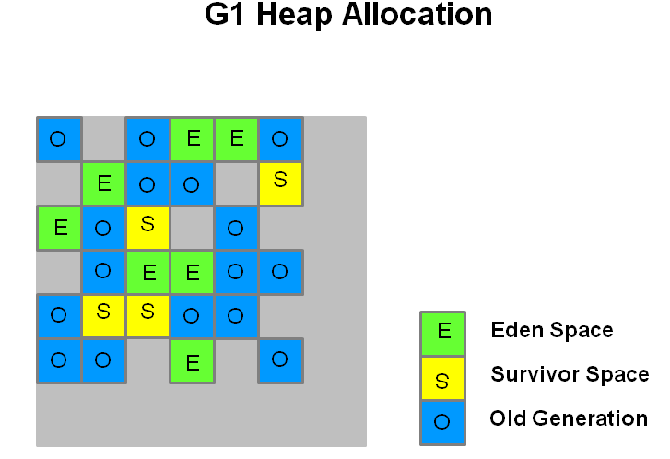


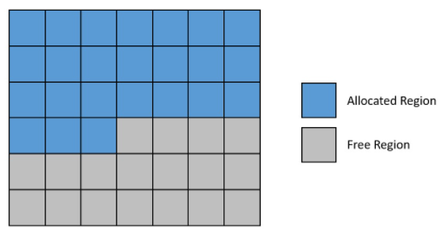
Garbage Collectors Implementations
G1 (Garbage First, or compacting-collector) Garbage Collector – incremental GC. Paper 2004, experimental in Java 6, official in Java 7, and default GC since Java 9. Designed for apps running on multi-cores with large memory space. Goal is: Througput/Latency balance. Tuneable pause goals. A bit more CPU intensive. Regions (#2000, size 2MB for 4GB heap)
Evacuation (moved/copied between regions). Minor & Major collection,..
>java -XX:+UseG1GC -jar App.java
Epsilon Collector – A No-Op GC. Apps with predictable, bounded memory usage, performance[stress] testing, short-lived obj. Allocates memory but not collect any garbage (memory allocation), once the Java heap is exhausted, the JVM will shut down. Params: -XX:+UnlockExperimentalVMOptions, -XX:+UseEpsilonGC
Z Garbage Collector (ZGC is scalable low latency GC) [pause time under 10 ms, maybe in future 1 ms] – is a scalable low-latency garbage collector, experimental in Java 11 for Linux, in Java 14 for Win. & macOS. Since Java 15 ZGC is onwards. Single generation(all opt. done here via colored pointers), No pause time increase with heap size increase, Scale to multi-terabyte heaps. -XX:+UnlockExperimentalVMOptions, -XX:+UseZGC
Shenandoah Garbage Collector (derived from G1, scalable low-latency garbage collector) –
experimental in Java 12, [Brooks pointers] support large Heaps, Low pause times.
Contributed by RedHat to OpenJDK. Became product feature in Java 15. Oracle JDK and Open JDK
has not this feature. Single generation. Can be used in Java 8 so no need colored pointers like ZGC.
-XX:+UnlockExperimentalVMOptions -XX:+UseShenandoahGC
Notes:
https://docs.oracle.com/javase/9/gctuning/garbage-first-garbage-collector.htm#JSGCT-GUID-CE6F94B6-71AF-45D5-829E-DEADD9BA929D
https://codeahoy.com/2017/08/06/basics-of-java-garbage-collection/
GC pause times by performing more garbage collection work concurrently with the running Java program
https://wiki.openjdk.java.net/display/shenandoah/Main
Shenandoah’s key advance over G1 is to do more of its garbage collection cycle work concurrently with the application threads. G1 can evacuate its heap regions, that is, move objects, only when the application is paused, while Shenandoah can relocate objects concurrently with the application. To achieve the concurrent relocation, it uses what’s known as a Brooks pointer. This pointer is an additional field that each object in the Shenandoah heap has and which points back to the object itself.
ZGC – no like young old gen. Just directly deletes un-used objects.
Memory – used by colored references.
https://www.youtube.com/watch?v=WU_mqNBEacw
ZGC compacting via copying to new regions. -
Colored pointes – 64 bits (). Modern CPU uses 44 bits to address memory.
SO ZGS uses those un-used parts . 4bits for metadata info - … so pinter says if this OBJEST is good or died, …
You change the bit-of memory …
MAPS memory address in virtual memory – so still point to memory in physical address.
In G1 still – stop the WORLS exists. So, compacting phase was stop the world…..
ZGC –
Shenandoah -
More predictable GC pauses. Better heap utilization.
Parallelism and concurrency together.
https://docs.oracle.com/javase/7/docs/technotes/guides/vm/G1.html
https://www.youtube.com/watch?v=OhPGN2Av44E
ZGC – no like young old gen. Just directly deletes un-used objects.
Memory – used by colored references.
https://www.youtube.com/watch?v=WU_mqNBEacw
In G1 still – stop the WORLS exists. So, compacting phase was stop the world…..
ZGC –
Shenandoah – pointer to CLASS and knows object belong to where.
More predictable GC pauses. Better heap utilization.
Parallelism and concurrency together.
https://docs.oracle.com/javase/7/docs/technotes/guides/vm/G1.html
https://www.youtube.com/watch?v=OhPGN2Av44E
https://www.youtube.com/watch?v=Uj1_4shgXpk
https://www.youtube.com/watch?v=VCeHkcwfF9Q
https://www.youtube.com/watch?v=WU_mqNBEacw
https://www.youtube.com/watch?v=7k_XfLGu-Ts
Throughput – number of trx per second. Latency – maximum time of a transaction.
Unlike Serial and Parallel, MARKING PHASE OF G! is done concurrently.
It allows you to find all live OBJECTS without STOPPING THE Java APP.
It can be marked in several regions.
Aroung 2000 regions
Balance between Througput and Latency
- not suffering on fragmentation….
Higher pause goal – more throughput / higher latency
Lower pause goal – less throughput, lower latency
Introduction to the G1 Garbage Collector by Paul Su
In general terms, throughput is the rate of production or the rate at which something is processed.
Latency from a general point of view is a time delay between the cause and the effect of some physical change in the system being observed.
LATENCY: Delay from input into a system to provide the desired outcome.
THROUGH: A measure of how many units of information a system can process in a given amount of time.
The region sizes can vary from 1 MB to 32 MB depending on the heap size.
The goal is to have no more than 2048 regions. The eden, survivor, and old generations are logical sets of these regions and are not contiguous.
When performing garbage collections, G1 operates in a manner similar to the CMS collector. G1 performs a concurrent global marking phase to determine the liveness of objects throughout the heap. After the mark phase completes, G1 knows which regions are mostly empty. It collects in these regions first, which usually yields a large amount of free space. This is why this method of garbage collection is called Garbage-First. As the name suggests, G1 concentrates its collection and compaction activity on the areas of the heap that are likely to be full of reclaimable objects, that is, garbage. G1 uses a pause prediction model to meet a user-defined pause time target and selects the number of regions to collect based on the specified pause time target.
Technical description
The G1 collector achieves high performance and pause time goals through several techniques.
The heap is partitioned into a set of equal-sized heap regions, each a contiguous range of virtual memory. G1 performs a concurrent global marking phase to determine the liveness of objects throughout the heap. After the mark phase completes, G1 knows which regions are mostly empty. It collects in these regions first, which usually yields a large amount of free space. This is why this method of garbage collection is called Garbage-First. As the name suggests, G1 concentrates its collection and compaction activity on the areas of the heap that are likely to be full of reclaimable objects, that is, garbage. G1 uses a pause prediction model to meet a user-defined pause time target and selects the number of regions to collect based on the specified pause time target.
The regions identified by G1 as ripe for reclamation are garbage collected using evacuation. G1 copies objects from one or more regions of the heap to a single region on the heap, and in the process both compacts and frees up memory. This evacuation is performed in parallel on multi-processors, to decrease pause times and increase throughput. Thus, with each garbage collection, G1 continuously works to reduce fragmentation, working within the user defined pause times. This is beyond the capability of both the previous methods. CMS (Concurrent Mark Sweep ) garbage collection does not do compaction. ParallelOld garbage collection performs only whole-heap compaction, which results in considerable pause times.
It is important to note that G1 is not a real-time collector. It meets the set pause time target with high probability but not absolute certainty. Based on data from previous collections, G1 does an estimate of how many regions can be collected within the user specified target time. Thus, the collector has a reasonably accurate model of the cost of collecting the regions, and it uses this model to determine which and how many regions to collect while staying within the pause time target.
G1 is a generational, parallel, concurrent, and incrementally compacting low-pause collector. It works with copying in the young generation and mark-compact in the old generation:
G1, however, is also a regionalized collector and structures the heap area into smaller regions. This gives it the benefit of more predictable pauses. Targeted for multiprocessor machines with a large amount of memory, G1 is also not free from the pauses.
Garbage First Collector doesn’t work like other collectors and there is no concept of Young and Old generation space. When a garbage collection is invoked, it first collects the region with lesser live data, hence “Garbage First”.
Epsilon - passive or “no-op” collector, which means that it handles memory allocation but doesn't recycle it! So, when the heap runs out of memory, the JVM simply shuts down.
But why would we ever want to use a collector like that? Basically, any garbage collector has an indirect impact on the performance of the user program. It's very difficult to benchmark an application and understand the impact of garbage collection on it.
Epsilon serves exactly that purpose. It simply removes the impact of a garbage collector and lets us run the application in isolation. But, this expects us to have a very clear understanding of the memory requirements of our application. Consequently, we can achieve better performance from the application.
Yes ZGC provides a short pause times when cleaning up heap memories. However, it didn’t return unused heap memory to the operating system, this improved in Java 13. Added support for Win in Java 14, and became prod-feature in Java 15
ZGC performs all expensive work concurrently, without stopping the execution of application threads for more than 10 ms, which makes it suitable for applications that require low latency. It uses load barriers with colored pointers to perform concurrent operations when the threads are running and they are used to keep track of heap usage.
Further, the Z collector takes advantage of 64-bit pointers with a technique called pointer coloring. Here, the colored pointers store extra information about objects on the heap. The Z collector remaps objects using the extra information stored in the pointer to reduce memory fragmentation.
https://www.baeldung.com/jvm-experimental-garbage-collectors
For instance, Shenendoah attempts to perform object relocation and compaction concurrently.
This essentially means that the pause time in Shenandoah is no longer directly proportional to the heap size. Hence, it can provide consistent low-pause behavior, irrespective of the heap size.
Shenandoah is an experimental collector that has been introduced in Java 12 and is being positioned as a latency specialist. It tries to reduce pause times by doing more of its garbage collection work concurrently with the user program.
Shenandoah, like G1, is a regionalized collector. This means that it divides the heap area into a collection of equal-sized regions. A region is basically a unit of memory allocation or reclamation:
But, unlike G1 and other generational collectors, Shenandoah doesn't divide the heap area into generations. Therefore, it has to mark most of the live objects every cycle, which generational collectors can avoid.
https://www.baeldung.com/jvm-garbage-collectors
Default Server connector in Java 11.
G1 (Garbage First) Garbage Collector is designed for applications running on multi-processor machines with large memory space. It's available since JDK7 Update 4 and in later releases.
Serial Garbage Collector
This is the simplest GC implementation, as it basically works with a single thread. As a result, this GC implementation freezes all application threads when it runs. Hence, it is not a good idea to use it in multi-threaded applications like server environments.
However, there was an excellent talk by Twitter engineers at QCon 2012 on the performance of Serial Garbage Collector – which is a good way to understand this collector better.
The Serial GC is the garbage collector of choice for most applications that do not have small pause time requirements and run on client-style machines. To enable Serial Garbage Collector, we can use the following argument:

Slide 12

The Z Garbage Collector (ZGC): Low Latency in JDK 11with Per Liden
Notes:
The Z Garbage Collector (ZGC): Low Latency in JDK 11with Per Liden
https://www.youtube.com/watch?v=7k_XfLGu-Ts

Slide 13
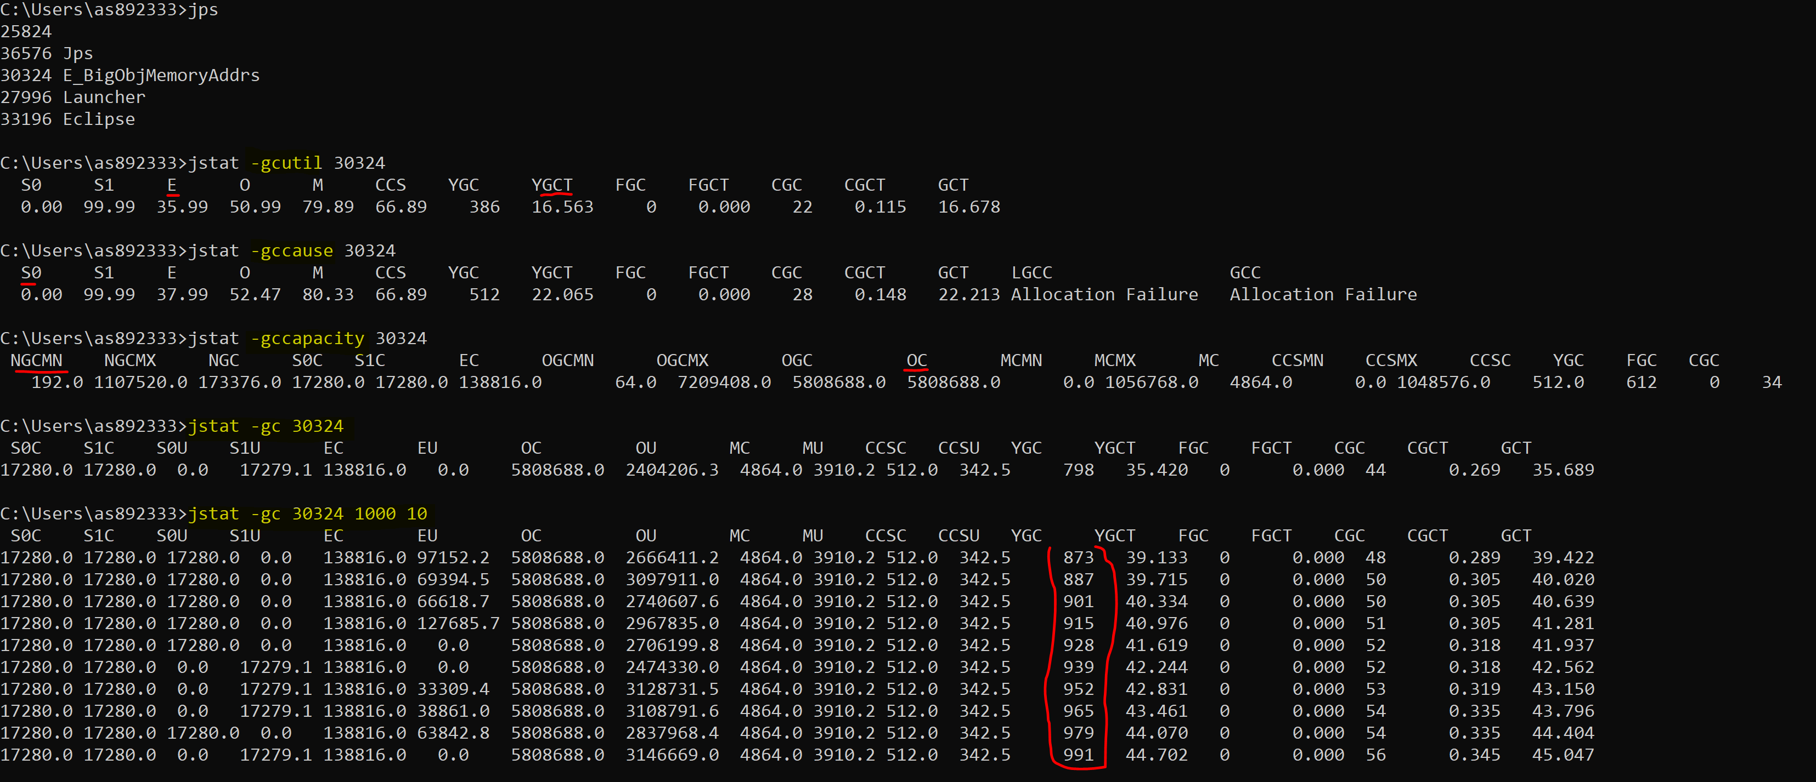
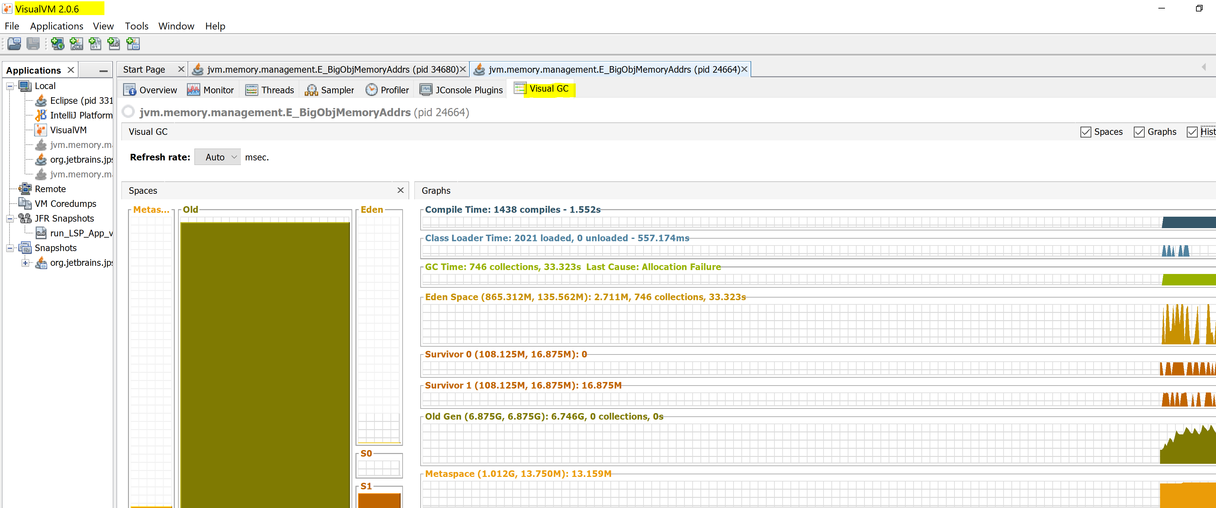
Garbage Collection Tools
MX Beans – management bean [GarbageCollectorMXBean] to monitor GC, to get name of garbage collections, numbers of collectors, times of collections and info about memories, … Each bean for per memory manager (old, young)
CODE: MainMXBeanDemo.java, E_BigObjMemoryAddrs
Run with: a) //default GC
b) -XX:+UseParallelGC
c) -XX:+UseConcMarkSweepGC
Jstat – command line tool to monitor memory and GC activities, also can be used to profile remote JVM
Run with: jstat –option <pid> <inteval> <count>
E.g. >jstat -gc 10632 100 10
Try with: -XX:+UseParallelGC, and G1
See jstat descriptions here
CODE: E_BigObjMemoryAddrs
Visualvm - VisualVM monitors and troubleshoots applications running on Java
Install Pluin for VisualGC
visualgc – get more info in VM what is happening on GC
Notes:
>jps - lists the instrumented Java HotSpot VMs on the target system.
>C:\apps\Java\visualvm_206\bin>visualvm.exe --jdkhome C:\apps\Java\jdk-11
Java Reference Objects
Java.lang.reference
https://www.dynatrace.com/news/blog/why-object-caches-need-to-be-memory-sensitive-guest-blog-by-christopher-andre/
https://www.cs.purdue.edu/homes/hosking/ismm2000/papers/boehm.pdf
Gccapacity - to see how mauch memory is allocated to generations,
Gcutil – gives statistics
Full gc – command – about on going GC

Slide 14

THANK YOU
References
https://docs.oracle.com/javase/8/docs/technotes/guides/vm/gctuning/g1_gc_tuning.html
https://www.baeldung.com/jvm-experimental-garbage-collectors
https://www.journaldev.com/2856/java-jvm-memory-model-memory-management-in-java
https://docs.oracle.com/javase/7/docs/technotes/guides/vm/G1.html
http://tutorials.jenkov.com/java-concurrency/java-memory-model.html
https://www.youtube.com/watch?v=WU_mqNBEacw
https://shipilev.net/
https://www.youtube.com/watch?v=Gee7QfoY8ys https://www.youtube.com/watch?v=WU_mqNBEacw

